Slide 1

Beginning

Slide 2
JCP
Java Community Process (JCP)
The Java Community Process (JCP) is an organization of international Java developers and licensees whose charter is to develop and revise Java technology specifications, reference implementations, and technology compatibility kits.
More information: https://jcp.org

Slide 3
JSR
Java Specification Requests (JSRs) are the actual descriptions of proposed and final specifications for the Java platform. At any one time there are numerous JSRs moving through the review and approval process.
Each specifications starts its life as a so-called Java Specification Request JSR. The JSRs are also known by the unique number they receive once the specification process starts. On the web site of the JCP you can find an overview page for each spec, and a separate download page. The download page lists various stages of each spec reflecting the development process of JCP specs. Examples are "Early Draft Review", "Public Final Draft" and "Final Release".

Slide 4
an exercise
I ask you to find a specification that works with the latest version of the servlet. For search to use https://jcp.org site.
Find information: servlets can run with what a Java platform. Provide a response in the form of text of the specification.
Also, determine which version of Java can be used to implement the Enterprise Edition 7 platform? Please use JSR 342.

Slide 5
What is an internet?
A set of interconnected networks
The Internet is the most famous example
Networks can be completely different
Ethernet, ATM, modem, …
(TCP/)IP is what links them

Slide 6
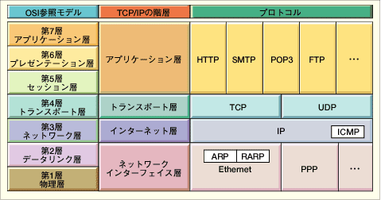
OSI and Protocol Stack
OSI: Open Systems Interconnect
OSI Model
TCP/IP Hierarchy
Protocols
7th
Application Layer
6th
Presentation Layer
Application Layer
5th
Session Layer
4th
Transport Layer
Transport Layer
3rd
Network Layer
Network Layer
2nd
Link Layer
Link Layer
1st
Physical Layer
Link Layer : includes device driver and network interface card
Network Layer : handles the movement of packets, i.e. Routing
Transport Layer : provides a reliable flow of data between two hosts
Application Layer : handles the details of the particular application

Slide 7
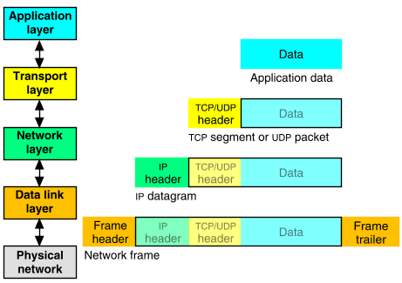
Packet Encapsulation
The data is sent down the protocol stack
Each layer adds to the data by prepending headers
22Bytes
20Bytes
20Bytes
4Bytes
64 to 1500 Bytes

Slide 8
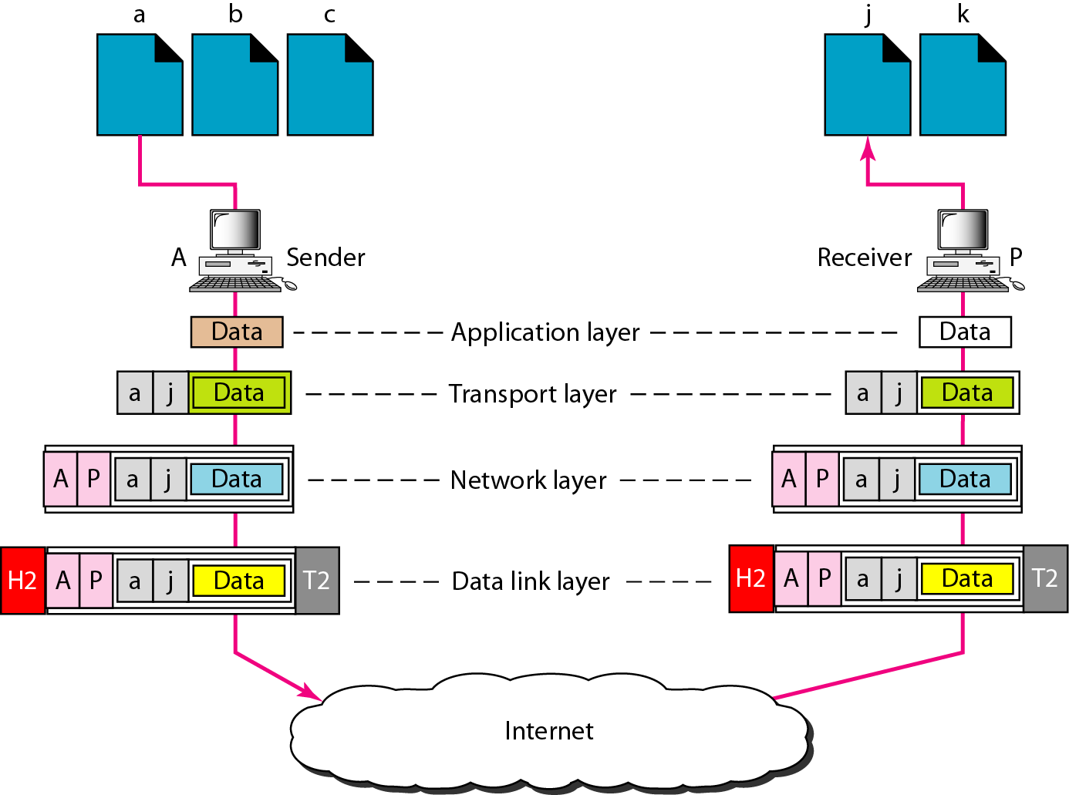
Port addresses

Slide 9
IP
The Internet Protocol (IP) is the method or protocol by which data is sent from one computer to another on the Internet. Each computer (known as a host) on the Internet has at least one IP address that uniquely identifies it from all other computers on the Internet.
IP is a connectionless protocol, which means that there is no continuing connection between the end points that are communicating. Each packet that travels through the Internet is treated as an independent unit of data without any relation to any other unit of data.

Slide 10
Dotted Decimal Notation
IP addresses are written in a so-called dotted decimal notation
Each byte is identified by a decimal number in the range [0..255]:
Example:
10000000
10001111
10001001
10010000
1st Byte
= 128
2nd Byte
= 143
3rd Byte
= 137
4th Byte
= 144
128.143.137.144

Slide 11
Dotted Decimal Notation
IP addresses are written in a so-called dotted decimal notation
Each byte is identified by a decimal number in the range [0..255]:
Example:
10000000
10001111
10001001
10010000
1st Byte
= 128
2nd Byte
= 143
3rd Byte
= 137
4th Byte
= 144
128.143.137.144

Slide 12
TCP Protocol
application
application
socket
writes data
reads data
socket
layer
TCP
TCP
layer
send buffer
data segment
receive buffer
ACK segment
Provides a reliable, in-order, byte stream abstraction:
Recover lost packets and detect/drop duplicates
Detect and drop corrupted packets
Preserve order in byte stream, no “message boundaries”
Full-duplex: bi-directional data flow in same connection
Flow and congestion control:
Flow control: sender will not overwhelm receiver
Congestion control: sender will not overwhelm the network
Sliding window flow control
Send and receive buffers
Congestion control done via adaptive flow control window size

Slide 13


Establishing a TCP Connection
Client sends SYN with initial sequence number (ISN = X)
Server responds with its own SYN w/seq number Y and ACK of client ISN with X+1 (next expected byte)
Client ACKs server's ISN with Y+1
The ‘3-way handshake’
X, Y randomly chosen
All modulo 32-bit arithmetic
client
server
connect()
listen()
port 80
SYN (X)
SYN (Y) + ACK (X+1)
ACK (Y+1)
time
accept()
read()

Slide 14
Ports
Used to address processes on a host
0-1024 is usually reserved for known service
FTP Server
Web Server
21
80
Transport
Layer
Network
Layer
DLL/Physical

Slide 15
Domain Name System (DNS)
Resolves domain names to IP addresses
and vice versa
DNS Server
www.refer.com
130.182.125.66

Slide 16
An HTTP conversation
Client
Server
OK
Send page or error message
OK
I would like to open a connection
GET <file location>
Display response
Close connection
HTTP is the set of rules governing the format and content of the conversation between a Web client and server

Slide 17
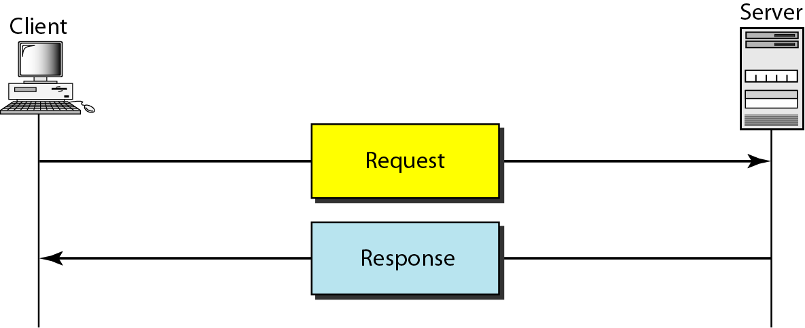
HTTP transaction

Slide 18
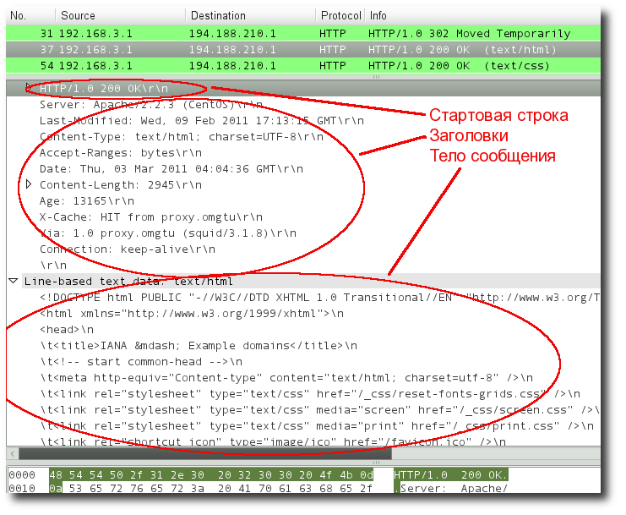
Protocol structure

Slide 22
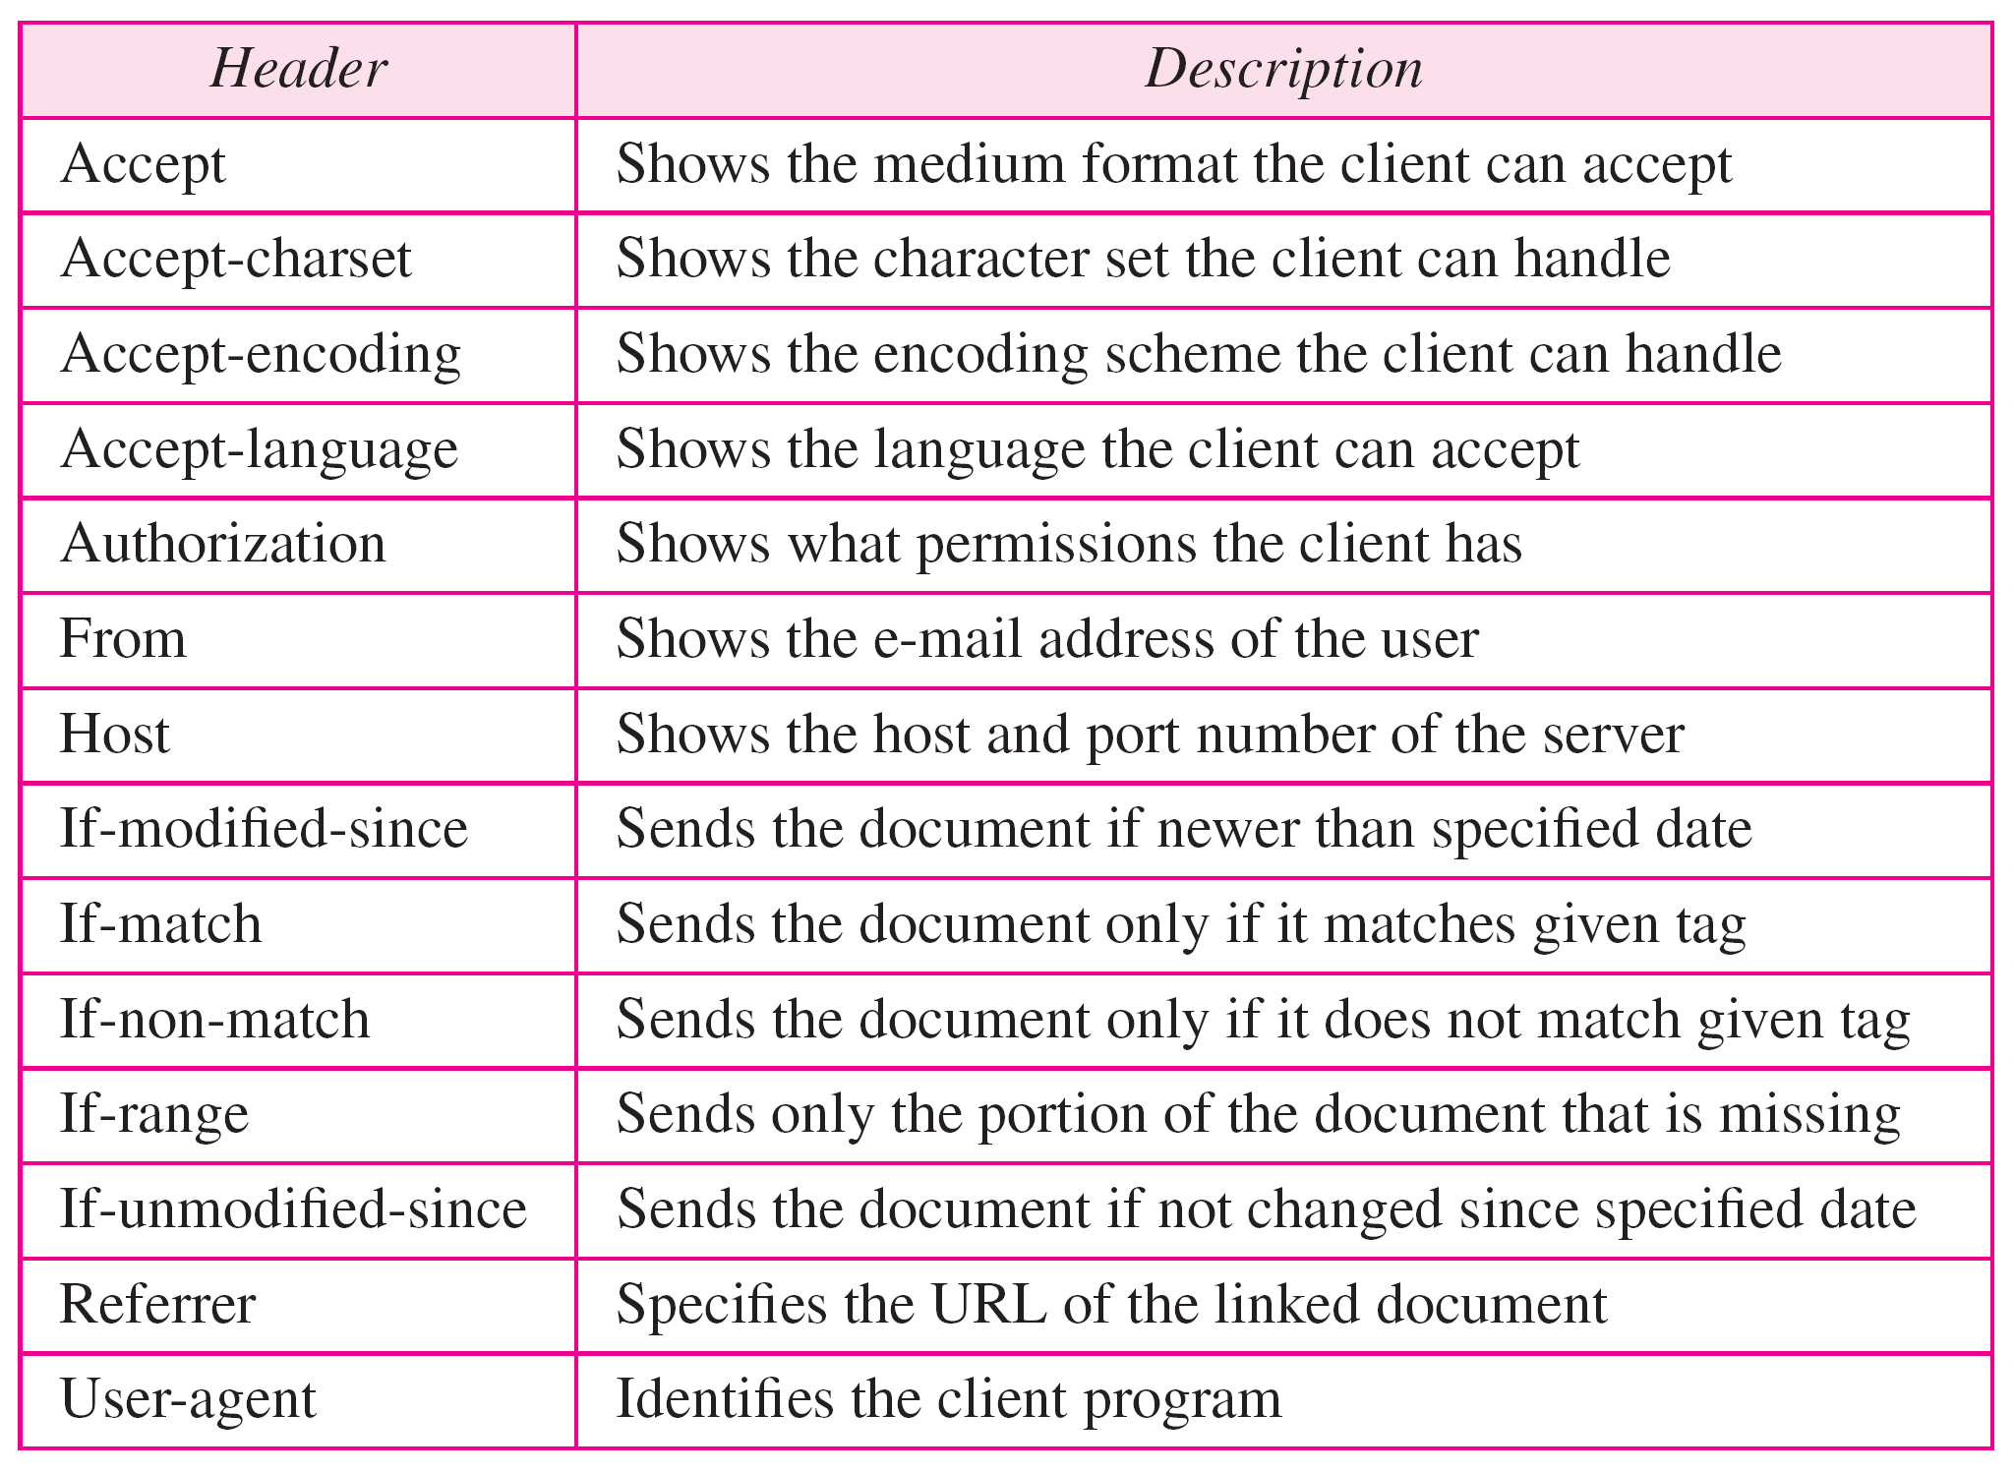

Slide 23
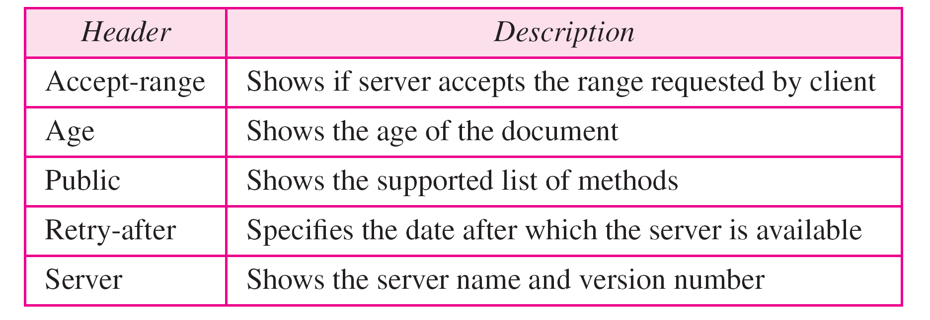

Slide 24
Request Headers example
GET http://www.example.org/ HTTP/1.1
Host: www.example.org
User-Agent: Mozilla/5.0 (X11; U; Linux i686; ru; rv:1.9.2.13) Gecko/20101203
SUSE/3.6.13-0.2.1 Firefox/3.6.13
Accept: text/html,application/xhtml+xml,application/xml;q=0.9,*/*;q=0.8
Accept-Language: ru-ru,ru;q=0.8,en-us;q=0.5,en;q=0.3
Accept-Encoding: gzip,deflate
Accept-Charset: windows-1251,utf-8;q=0.7,*;q=0.7
Keep-Alive: 115
Proxy-Connection: keep-alive
HTTP/1.0 302 Moved Temporarily
Date: Thu, 03 Mar 2011 06:48:28 GMT
Location: http://www.iana.org/domains/example/
Server: BigIP
Content-Length: 0
X-Cache: MISS from proxy.omgtu
Via: 1.0 proxy.omgtu (squid/3.1.8)
Connection: keep-alive

Slide 25
Response Headers example
HTTP/1.0 200 OK
Server: Apache/2.2.3 (CentOS)
Last-Modified: Wed, 09 Feb 2011 17:13:15 GMT
Content-Type: text/html; charset=UTF-8
Accept-Ranges: bytes
Date: Thu, 03 Mar 2011 04:04:36 GMT
Content-Length: 2945
Age: 9858
X-Cache: HIT from proxy.omgtu
Via: 1.0 proxy.omgtu (squid/3.1.8)
Connection: keep-alive

Slide 26
Task 2
Write an HTTP server code that you can run and to give a response the browser a simple HTML page.
Use in the code Socket, ServerSocket, InputStream, OutputStream, and Thread.

Slide 29

HTML

Slide 30
HTML (Hypertext MarkUP Language)
HTML is the lingua franca for publishing hypertext on the World Wide Web
Define tags <html><body> <head>….etc
Allow to embed other scripting languages to manipulate design layout, text and graphics
Platform independent
For more info: http://www.w3.org/MarkUp/

Slide 31
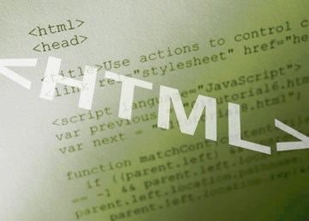


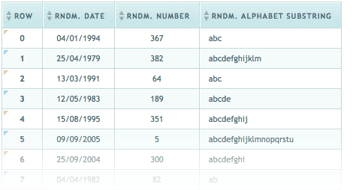
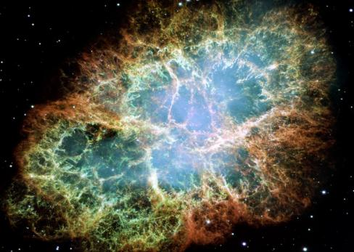
HTML Basics
Text, Images, Tables, Forms

Slide 32
Creating HTML Pages
An HTML file must have an .htm or .html file extension
HTML files can be created with text editors:
NotePad, NotePad ++, PSPad
Or HTML editors (WYSIWYG Editors):
Microsoft FrontPage
Macromedia Dreamweaver
Netscape Composer
Microsoft Word
Visual Studio
Directory of tags https://webref.ru/html

Slide 33


Slide 34
Structure of the web page
<!DOCTYPE html>
<html>
<head>
<title> CGS 2100 </title>
<meta charset="utf-8">
</head>
<body>
This is a sample HTML file.
</body>
</html>
The content of the whole web page should be put here

Slide 35

Color in HTML
FA | + | 8E | + | 47 | = | FA8E47

Slide 36
HTML (Hypertext Markup Language)
Example HTML code:
<HTML>
<head>
<title>Hello World</title>
</head>
<body bgcolor = “#FA8E47”>
<font color = “#ffffff”>
<H1>Hello World</H1>
</font>
</body>
</HTML>

Slide 37
Size px
<!DOCTYPE HTML PUBLIC "-//W3C//DTD HTML 4.01 Transitional//EN" "http://www.w3.org/TR/html4/loose.dtd">
<html>
<head>
<meta http-equiv="content-type" content="text/html; charset=utf-8">
<title>Изображение</title>
</head>
<body>
<p><img src="images/figure.jpg" alt="Винни-Пух в гостях у Кролика"
width="100" height="111" hspace="4" vspace="4" border="2"></p>
</body>
</html>

Slide 38
Size %
<!DOCTYPE HTML PUBLIC "-//W3C//DTD HTML 4.01//EN" "http://www.w3.org/TR/html4/strict.dtd">
<html>
<head>
<meta http-equiv="content-type" content="text/html; charset=utf-8">
<title>Изображение</title>
</head>
<body>
<p><img src="images/figure.jpg" alt="Винни-Пух в гостях у Кролика" width="100%"></p>
</body>
</html>

Slide 39
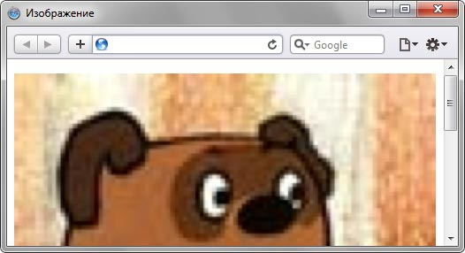
Example

Slide 40
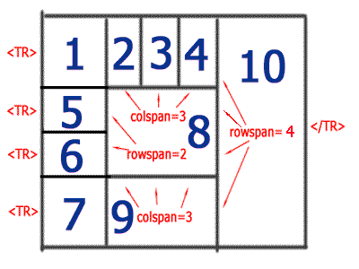
Table

Slide 41
<TABLE border=3> <TR> <TD>1 ячейка</TD> <TD>2 ячейка</TD> <TD>3 ячейка</TD> <TD>4 ячейка</TD> <TD rowspan=4>10 ячейка</TD> </TR> <TR> <TD>5 ячейка</TD> <TD colspan=3 rowspan=2>8 ячейка</TD> <TR> <TD>6 ячейка</TD> <TR> <TD>7 ячейка</TD> <TD colspan=3>9 ячейка</TD> </TABLE>

Slide 42
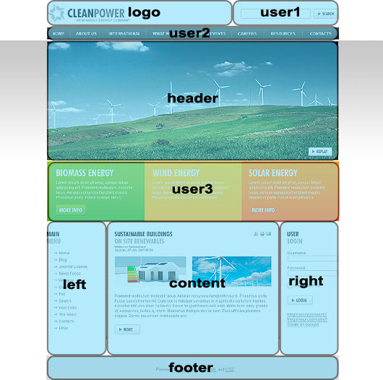
Block layout

Slide 43
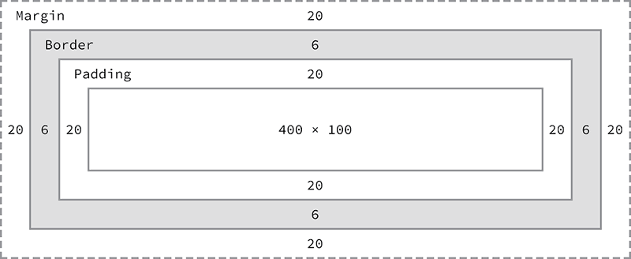
div size

Slide 44
div
<div style="border:1px solid #000000;
width:150px;
height:100px;
margin-top:20px;
margin-right:10px;
margin-bottom:150px;
margin-left:130px;
padding-top:30px;
padding-left:15px;
background-color:green;">
<a href="http://uzeron.com/index.php">Link</a>
</div>

Slide 45
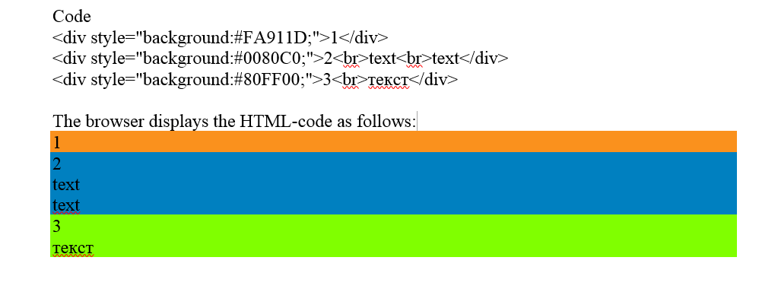
div style

Slide 46
div style

Slide 47
div style

Slide 48
div style

Slide 49
div style

Slide 50

CSS

Slide 51
syntax of tag <style>
<head>
...
<style type="text/css">
...
description styles
...
</style>
...
</head>

Slide 52
inline
<p style=" color:blue; background-color:white; "> paragraph text</p>
<div style="background:#808080;">div block content</div>

Slide 53
Code
<link rel="stylesheet" type="text/css" href="mystyle.css">
File mystyle.css
body { color:red; } h1.zagol_anekdot { color:blue; background-color:#00FF80; } p.anekdot { color:black; } h1.zagol_history {color: #B5930B; background-color:#00FFFF;} p.history {color: #408080; }

Slide 54
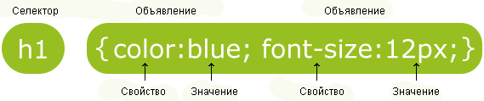
css syntax

Slide 55
class in CSS

Slide 56
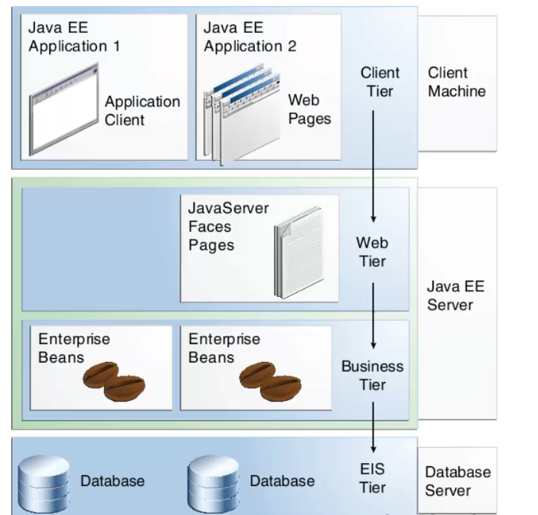
Structure J2EE

Slide 57
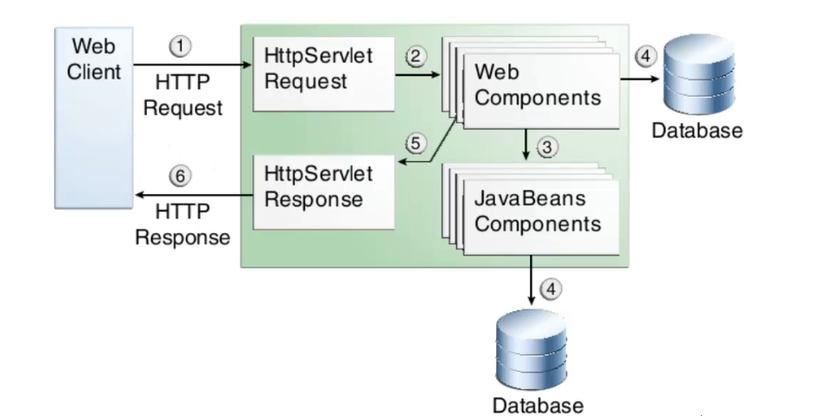
HTTP request - response

Slide 58
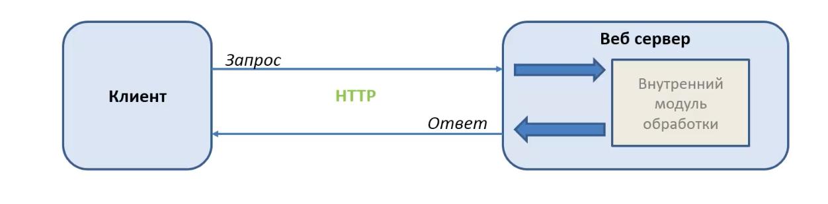
Request to web server

Slide 59
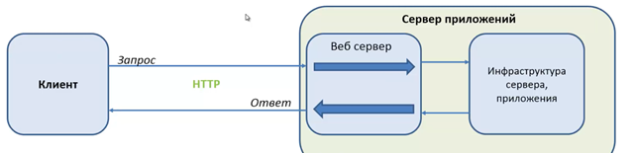
Request to application server

Slide 60
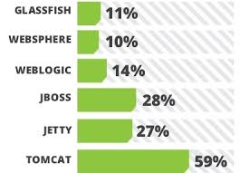
Type of application servers

Slide 61
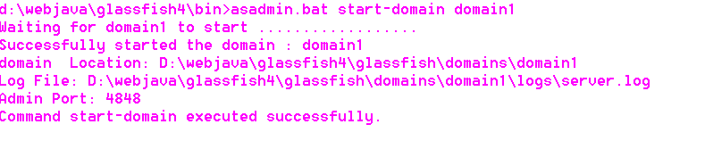
Installing GlassFish 4
Download and unzip JAVA EE 7 SDK from https://www.oracle.com/java/index.html
In the Terminal Windows switch to the directory glassfish4/bin and run asadmin.bat start-domain domain1
If the server started successfully, you will see

Slide 62
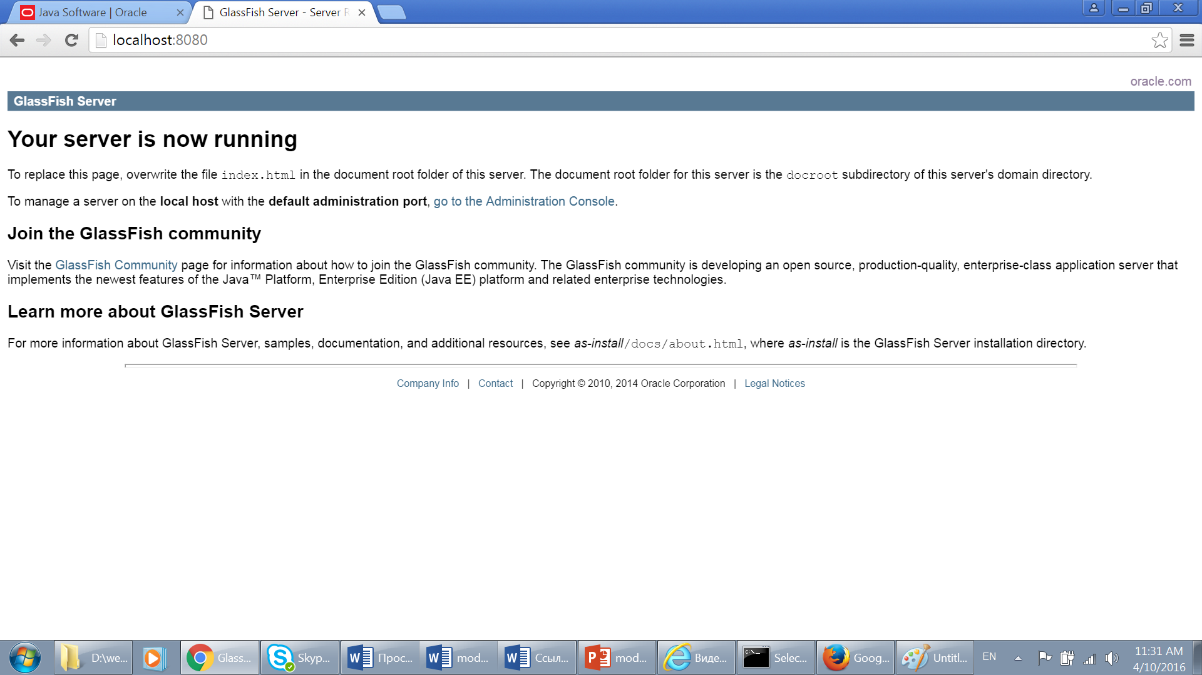
On the port 8080

Slide 63
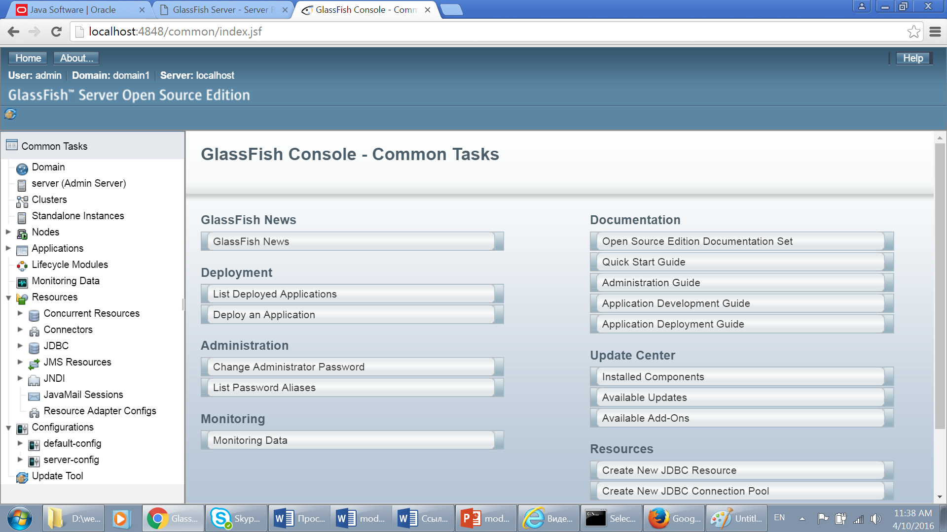
GlassFish Console

Slide 64
execute
Create new servlet: right-click on the project name and select New| Servlet. Specify com.epam.webjava.tarasau as the name of Java package and FindBooks as the class name. Press Next.
In the URL Mappings box select FindBooks, press Edit, and enter /book in the Patterns field. Press OK and Finish.
Add the following two lines inside the method doGet:
PrintWriter out = response.getWriter();
out.println(“Hello from FindBooks”);
Correct the errors by importing the PrintWriter class.
Deploy the servlet in GlassFish.
Run the servlet.

Slide 65


Slide 66
Tags
<font color="red">rose</font>
<flower>rose</flower>
<conservatory>
<flower>rose</flower>
<flower>tulip</flower>
<flower>cactus</flower>
</conservatory>

Slide 67
xml document structure
<?xml version="1.0" encoding="UTF-8"?> <note> <to>Tove</to> <from>Jani</from> <heading> reminder</heading> <body> Do not forget me this weekend!</body> </note>

Slide 68
Example

Slide 69
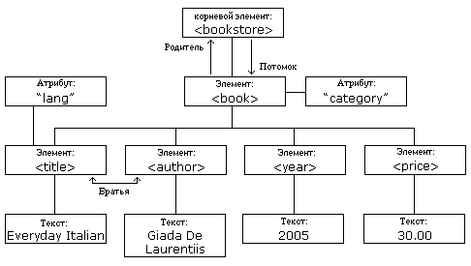
structure

Slide 70
xml document
<bookstore> <book category="COOKING"> <title lang="en">Everyday Italian</title> <author>Giada De Laurentiis</author> <year>2005</year> <price>30.00</price> </bookstore>

Slide 71
xml document
<?xml version="1.0" encoding="windows-1251" ?>
<ROOT>
<EMPTY-ELEMENT string-attribute="Иван" />
<OPENED-ELEMENT>
<INTERNAL-ELEMENT />
</OPENED-ELEMENT>
<TYPE_SAMPLES>
< !-- Примеры записи в XML различных типов данных -->
<NUMERIC>
<INTEGER value="100203" />
<DOUBLE varian-1="333.4445454" variant-2="333.44E2" />
</NUMERIC>
<DateTime>
<DATE value="2001-02-03" />
<DATE-TIME value="2001-02-03T12:30:44" value1="2001-02-03T12:30:44+UTC3">
<errors err1="01/02/2001" />
</DATE-TIME>
<DateTimeDuration value="P4028DT11H10M59S" />
</DateTime>
</TYPE_SAMPLES>
<CDATA-ELEMENT-SAMPLE>
<![CDATA[
Здесь можно поместить любой набор символов
werlkgj lwkejrg lkwejlg
jwelg <> = dj klklg se
]]>
</CDATA-ELEMENT-SAMPLE>
<TEXT-SAMPLE>Здесь может быть любое текстовое значение</TEXT-SAMPLE>
</ROOT>

Slide 72
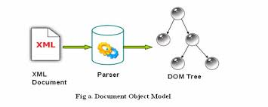
DOM parser

Slide 73
MyXMLFile.xml
<?xml version="1.0"?>
<company>
<employee>
<firstname>Tom</firstname>
<lastname>Cruise</lastname>
</employee>
<employee>
<firstname>Paul</firstname>
<lastname>Enderson</lastname>
</employee>
<employee>
<firstname>George</firstname>
<lastname>Bush</lastname>
</employee>
</company>

Slide 74
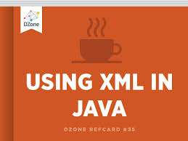

Slide 75
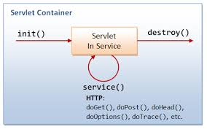
Servlets

Slide 76
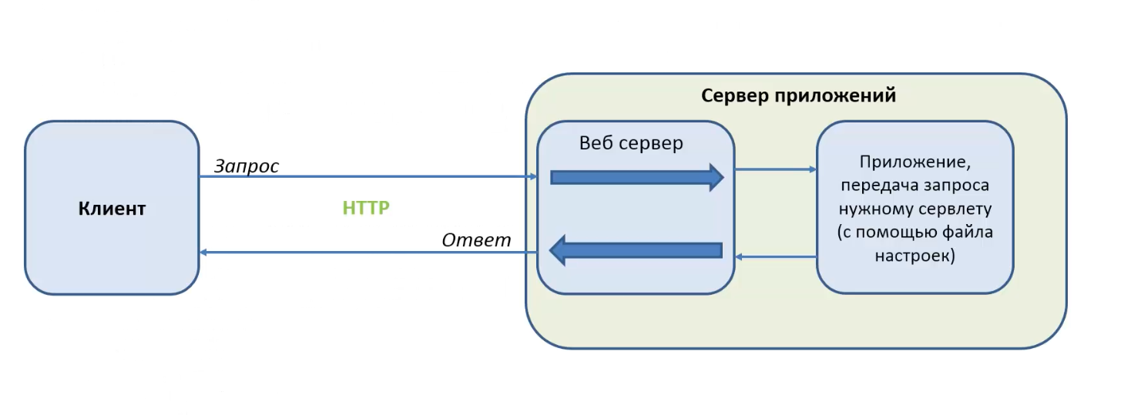
Servlet

Slide 77
Methods of servlet
void doGet(HttpServletRequest request, HttpServletResponse response){} void doPost(HttpServletRequest request, HttpServletResponse response){}
void processRequest(HttpServletRequest request, HttpServletResponse response){}

Slide 78
processRequest
protected void processRequest(HttpServletRequest request, HttpServletResponse response) throws ServletException, IOException { response.setContentType("text/html;charset=UTF-8"); PrintWriter out = response.getWriter(); try { out.println(""); out.println(""); out.println("Servlet MyServlet"); out.println(""); out.println(""); out.println("Servlet MyServlet at " + request.getContextPath () + ""); out.println(""); out.println(""); } finally { out.close(); } }

Slide 79
Task1
Please create a servlet that to use the image. Servlet should display the name of the image and below the image. Use the methods processRequest() and out.println()

Slide 80
example
try {
out.println("<html>"
+ "<head>"
+ "<meta http-equiv=\"content type\" content=\"text/html\";charset=\"UTF-8\">"
+ "<title>Document</title>"
+ "</head>"
+ "<body>"
+ "<table width=\"600\" border=\"0\" cellpadding=\"0\" cellspacing=\"15\">"
+ "<tr>"
+ "<td colspan=\"2\" align=\"center\"><strong><font color=\"#FF0000\" size=\"5\">Project participants</font></strong></td>"
+ "</tr>“
…
+ "</table>"
+ "</body>"
+ "</html>");
} finally {
out.close();
}
}

Slide 81
Task 2
Please create a servlet based on an HTML document of the second module with a table layout

Slide 82
Task 3
Please create a servlet based on an HTML document of the second module with a block layout and using CSS

Slide 83
Task 4
Create a servlet that will implement the calculator capabilities. Parameters of servlet: numeral one, numeral two, operation (add,subtract, multiply,divide). Please use in the project the java class Calcoperations (slide 10) and enum (slide 11).

Slide 84
CalcOperations
package calc;
public class CalcOperations {
public static double add(double a, double b) {
return a + b;
}
public static double subtract(double a, double b) {
return a - b;
}
public static double multiply(double a, double b) {
return a * b;
}
public static double divide(double a, double b) {
return a / b;
}
}

Slide 85
Enum OperationType
package calc;
public enum OperationType {
ADD("+"),
SUBTRACT("-"),
MULTIPLY("*"),
DIVIDE("/");
private String stringValue;
private OperationType(String stringValue) {
this.stringValue = stringValue;
}
public String getStringValue() {
return stringValue;
}
}

Slide 86
try
read the parameters from the request
double one = Double.valueOf(request.getParameter("one").toString()).doubleValue();
double two = Double.valueOf(request.getParameter("two").toString()).doubleValue();
String opearation = String.valueOf(request.getParameter("operation")); 2. define or create session
HttpSession session = request.getSession(true); 3. get the type of operation
OperationType operType = OperationType.valueOf(opearation.toUpperCase()); 4. carry out the calculation
double result = calcResult(operType, one, two);

Slide 87
Questions?
Thank you

